Slide 1
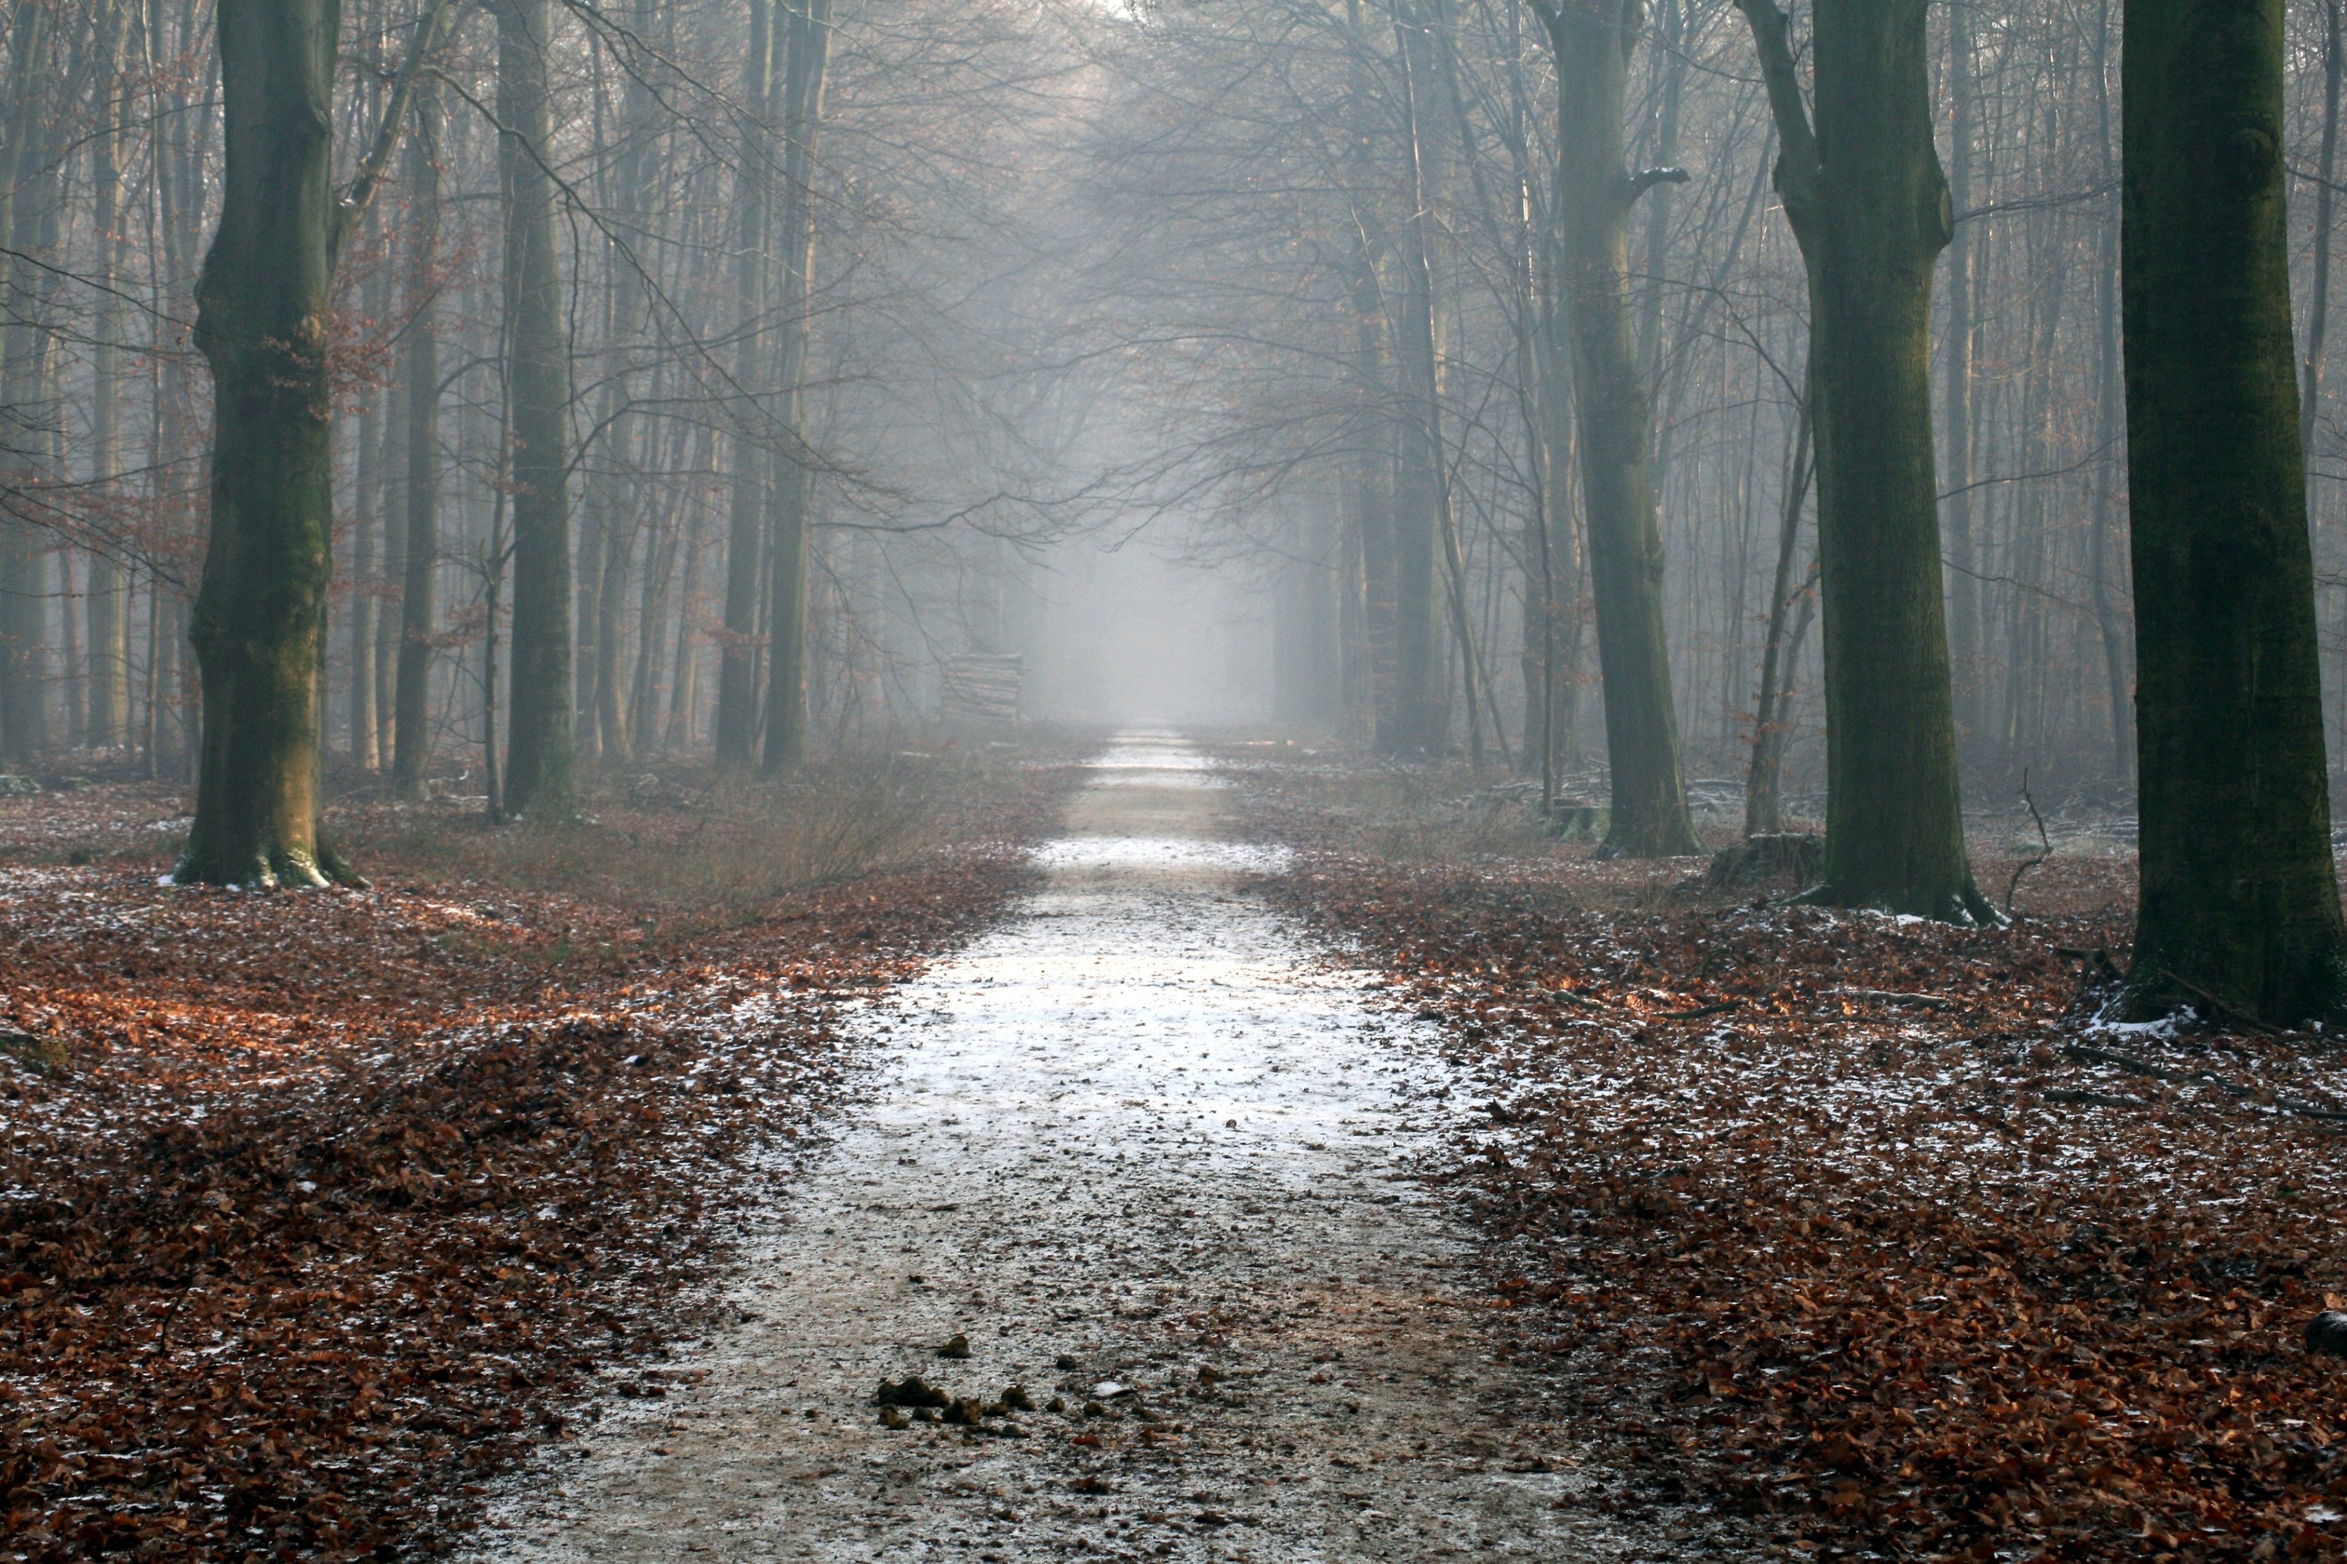
Monday
play

Slide 2
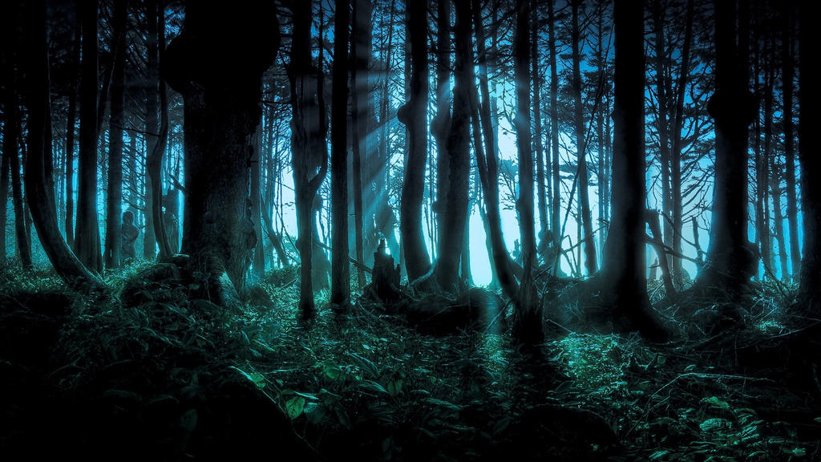
Select chapter
Chapter 1

Slide 3
Hello…

Slide 4
Are You Going To Listen Scary Story About
“Monday?”

Slide 5
On 28 December 2009 The Little Child
Have A Bad Dream

Slide 6
28 December 2009 At 6:00 AM

Slide 7

Play in playground

Slide 8
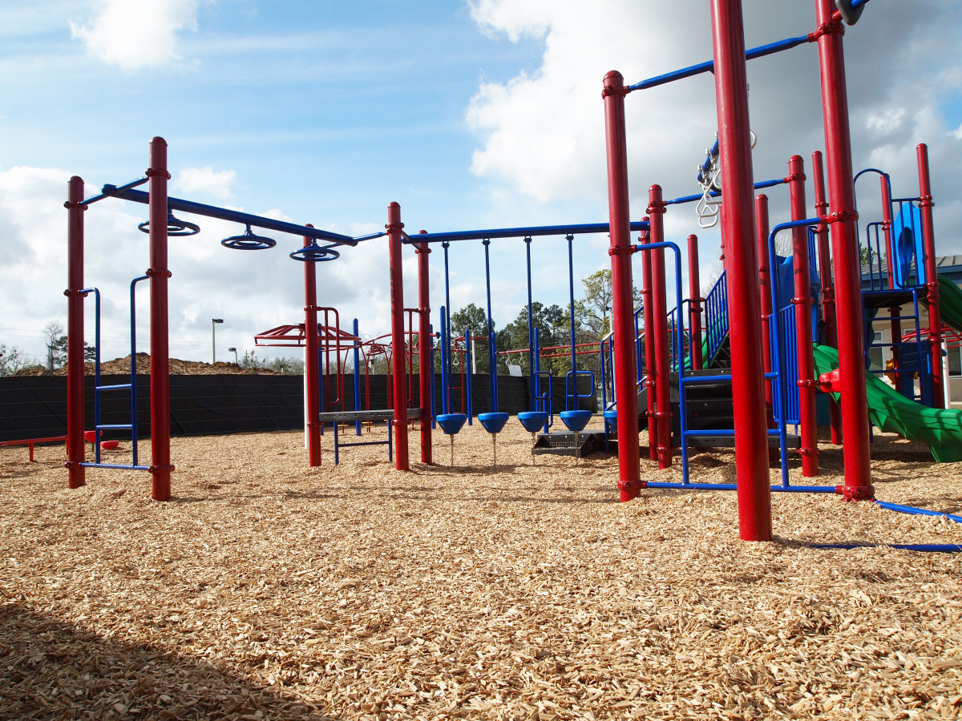
Go To Home

Slide 9
1 Hour Later

Slide 10
28 December 2009 At 7:00 AM

Slide 11

BASEMENT

Slide 12
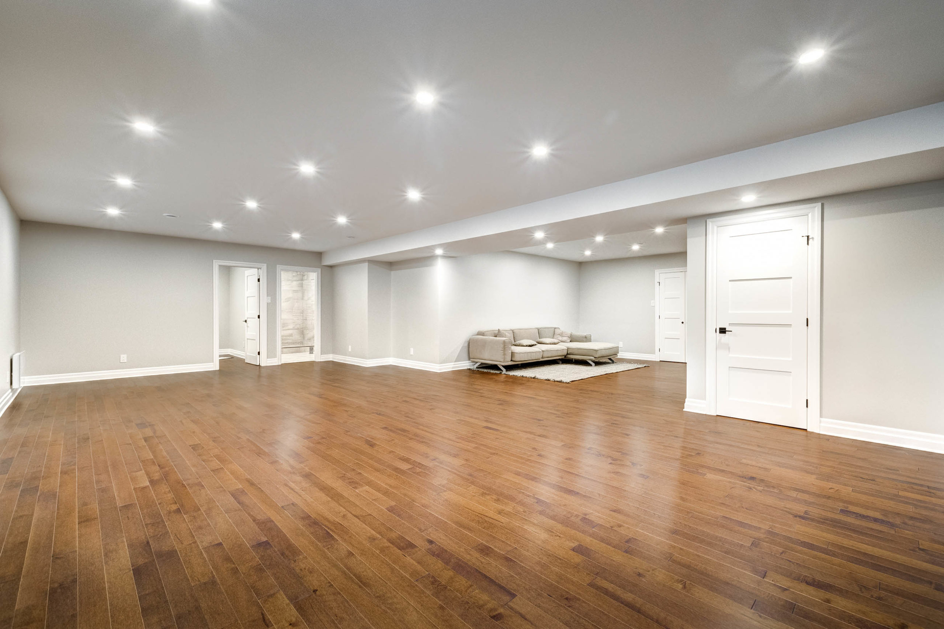

Slide 16
3 Hour Later

Slide 17
28 December 2009 At 9:00 AM

Slide 18
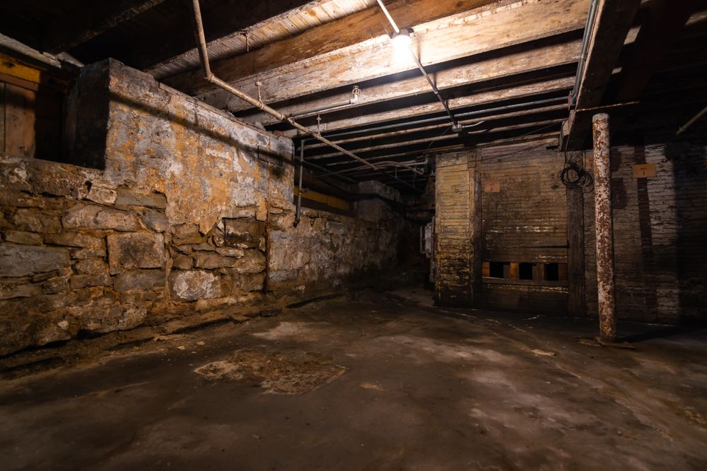
Go left
Go right
Wait For Part 2 To Select This

Slide 20
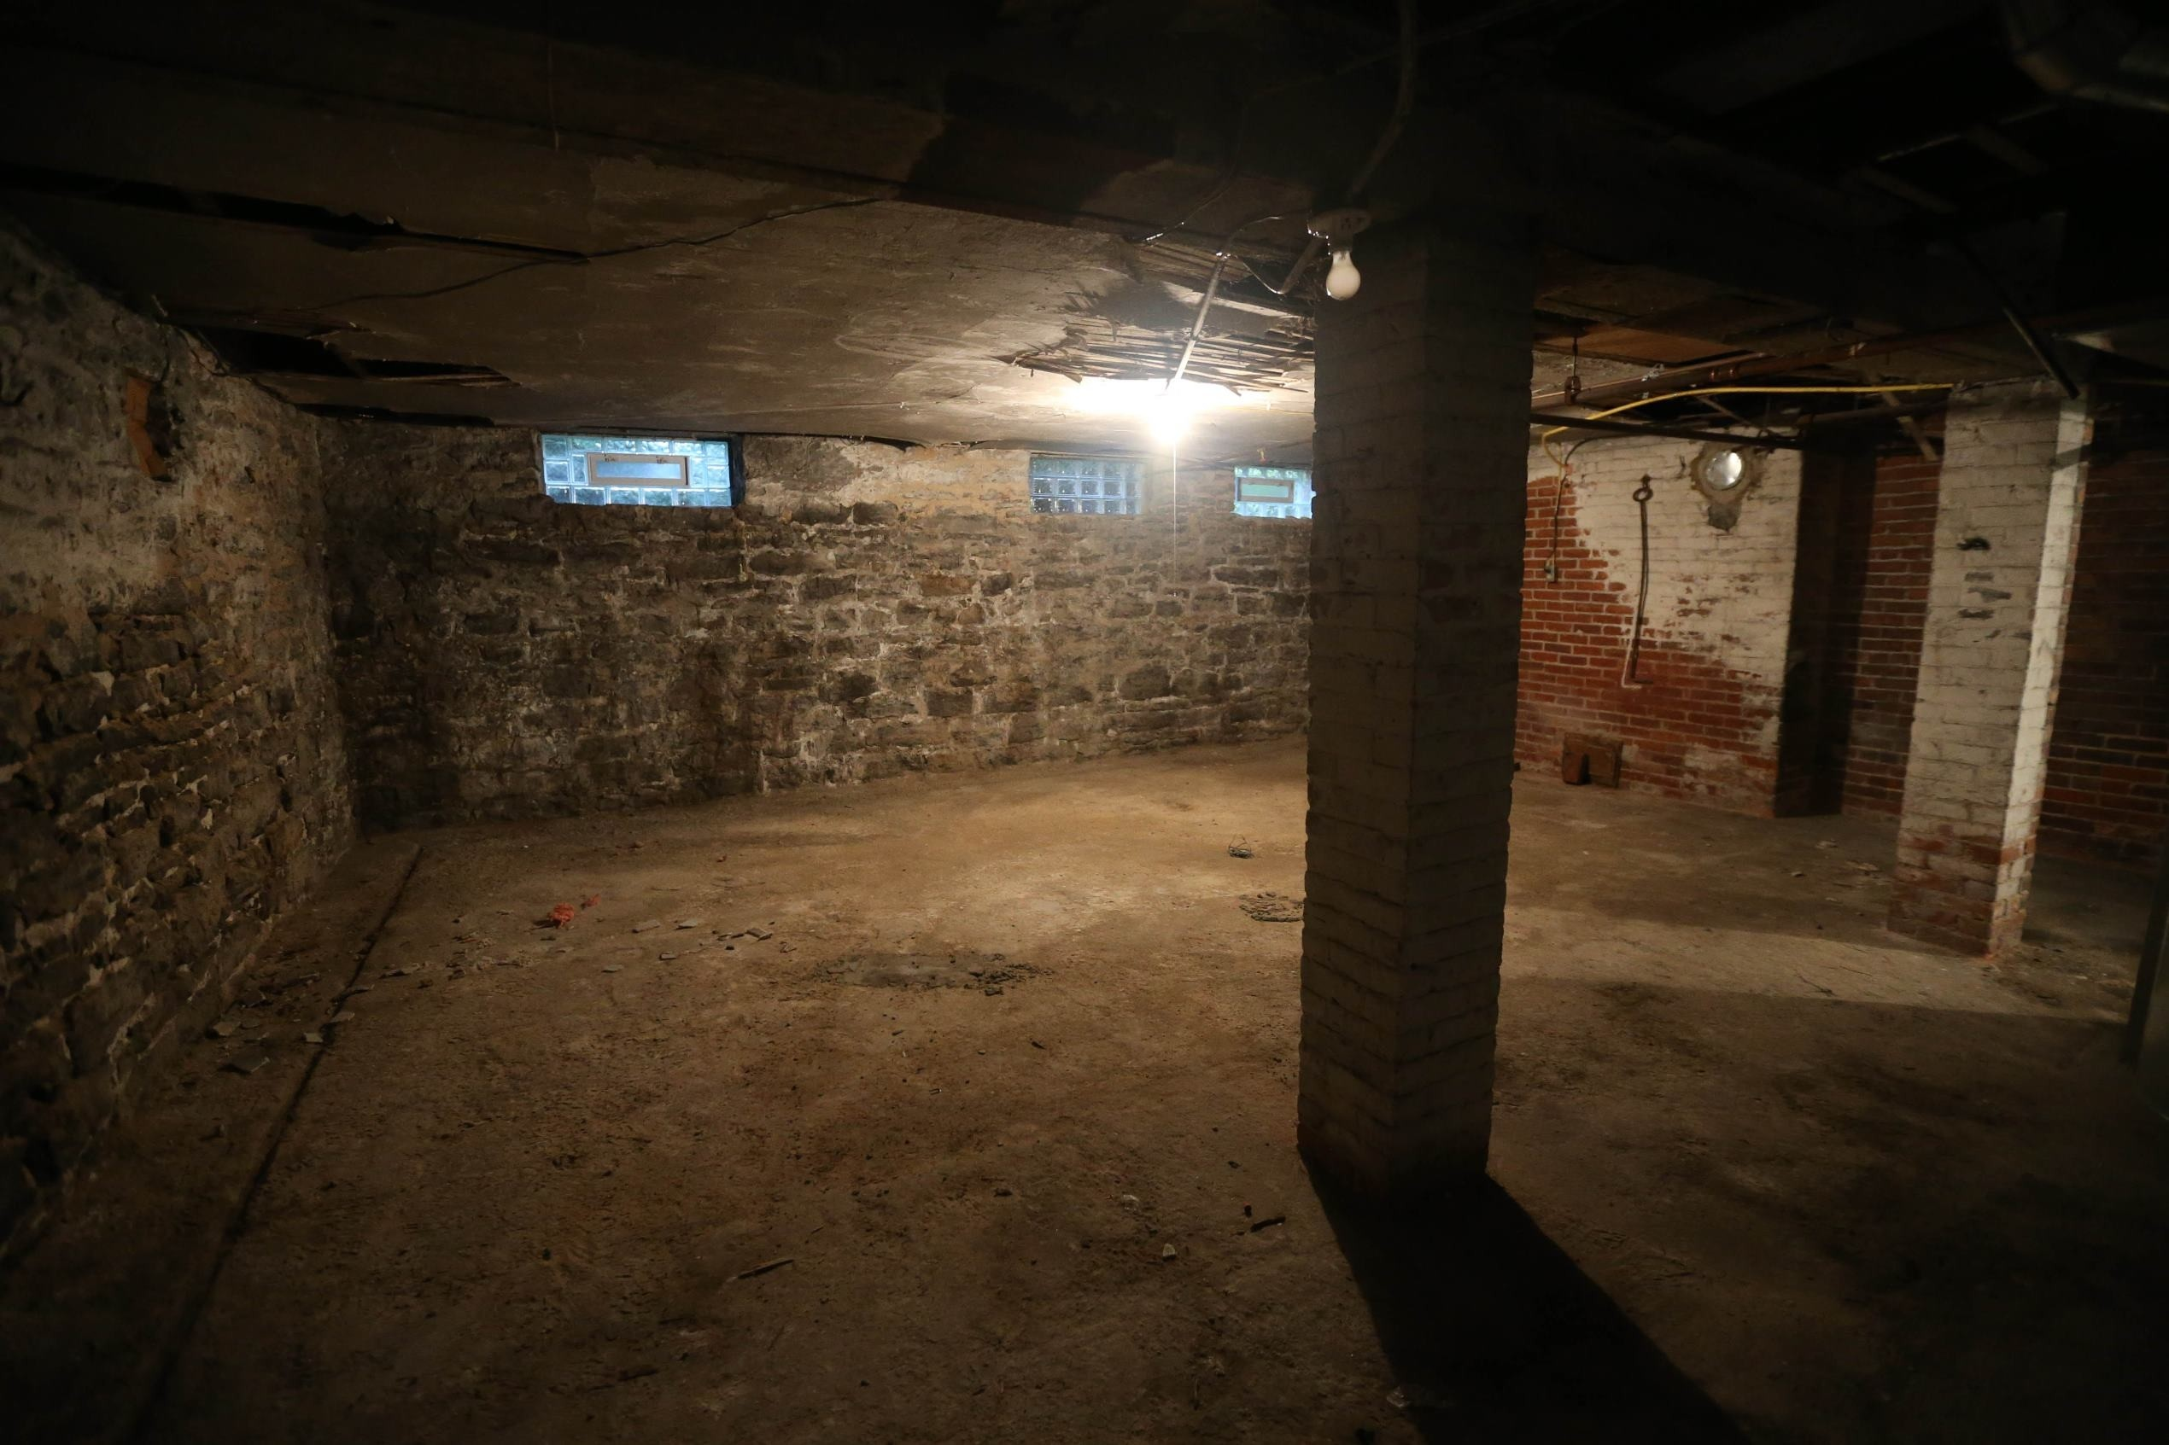

Slide 21
Part 2 Coming Soon

